Slide 1
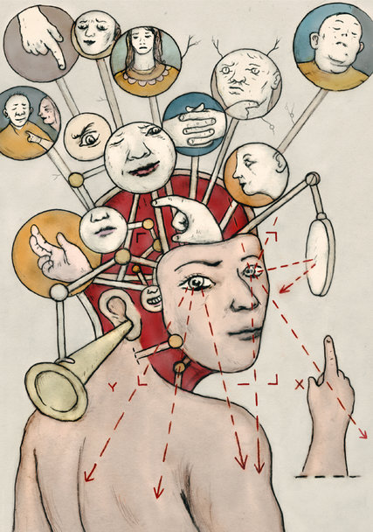
The Brain

Slide 2
What is it?

Slide 3
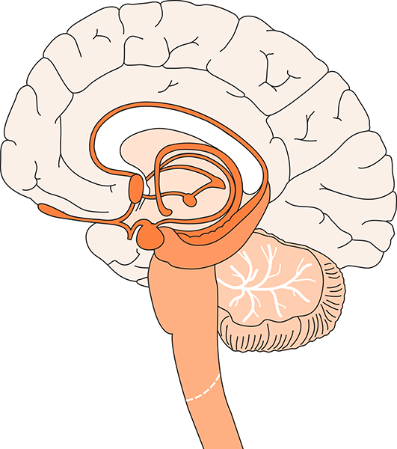
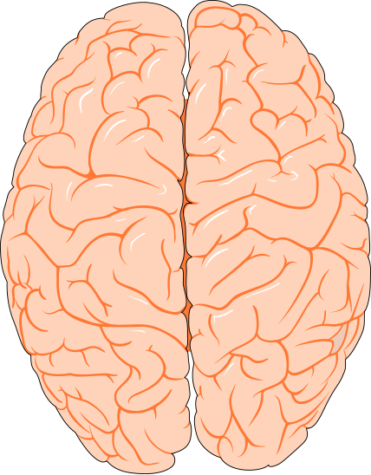
The Brain and Spinal Cord
Cerebrum
Cerebral Cortex
Corpus Callosum
Limbic System
Cerebral Hemispheres (top view)
Brain Stem
Cerebellum
Spinal Cord
Illustrations © Williams & Wilkins. All rights reserved.
Notes:
The brain of the average adult weighs about three pounds and fills over half the skull. Even though it is soft (like pudding), the brain can be divided into several regions, each with very specific functions.
The cerebrum, about 85% of the brain’s mass, sits above the brainstem and cerebellum. The surface of the cerebrum, known as the cerebral cortex, has bumps (gyri) and grooves (sulci). The cerebrum enables one to think, learn, reason, remember, feel sensations and emotions, and move muscles purposefully. It is comprised of two hemispheres (or halves), separated by a deep fissure.
The hemispheres are connected by a large bundle of nerve fibers known as the corpus callosum. They communicate with each other constantly. Even though the hemispheres may look the same, they are somewhat specialized for certain functions. For example, in most people, the ability to form words is a function that seems to be located within the left hemisphere, while the right hemisphere is better at processing spatial information. Different parts of each hemisphere handle specific functions, including hearing, vision, speech, memory, decision making and long-term planning.
The cerebellum sits at the back of the brainstem and is about the size of a tennis ball. It helps us maintain balance and posture, and coordinates our movements. The cerebellum also plays an important role in our ability to learn and remember new motor skills, such as riding a bike.
The limbic system is comprised of a number of interconnected brain regions, including areas within and under the cerebral hemispheres. It is involved in many emotions and motivations, especially those related to survival, such as anger, fear, and even the fight-or-flight response. The limbic system also plays an important role in feelings of pleasure, such as those experienced from eating and sex.
The brainstem connects directly with the spinal cord and is responsible for automatic functions of the body, including heartbeat, digestion, breathing, swallowing, coughing and sneezing. Automatic functions are present at birth and happen without thinking about them.
The brain’s main communication channel to the rest of the body is the spinal cord. Nerves branch out from the spinal cord and send and receive information.
Functions and abilities develop as the brain grows and matures. The human brain generally reaches close to 80% of its adult weight by the age of two or three, yet it continues to develop throughout adolescence and early adulthood. The region of the cerebral cortex responsible for judgment, organization and reasoning appears to be one of the last brain areas to reach maturity.
Reference:
From the Brain Chemistry Teacher’s Guide activity, “The Brain.” Brain Chemistry Teacher’s Guide © Baylor College of Medicine (ISBN: 978-1-888997-45-3) was supported, in part, by funds from the National Institutes of Health, Science Education Partnership Award grant number R25RR13454, and the NIH Blueprint for Neuroscience Research Science Education Award, National Institute on Drug Abuse and NIH Office of the Director, grant number 5R25DA033006.
Image reference:
Illustrations © Williams & Wilkins. All rights reserved.

Slide 4
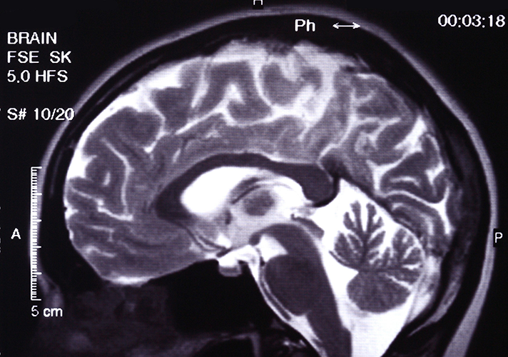
Internal Brain Structure
This MRI of a normal brain reveals the different regions of the brain, each of which has specific functions.
Such detailed images allow physicians to visualize diseases, effects of injuries and abnormalities in the brain.
Image © Mikhail Basov.
Notes:
In this MRI of a normal brain, the cerebrum, cerebellum, brain stem, and other regions of the brain are clearly visible.
Reference:
From the Brain Chemistry Teacher’s Guide activity, “The Brain.” Brain Chemistry Teacher’s Guide © Baylor College of Medicine (ISBN: 978-1-888997-45-3) was supported, in part, by funds from the National Institutes of Health, Science Education Partnership Award grant number R25RR13454, and the NIH Blueprint for Neuroscience Research Science Education Award, National Institute on Drug Abuse and NIH Office of the Director, grant number 5R25DA033006.
Image reference:
MRI © Mikhail Basov.

Slide 5
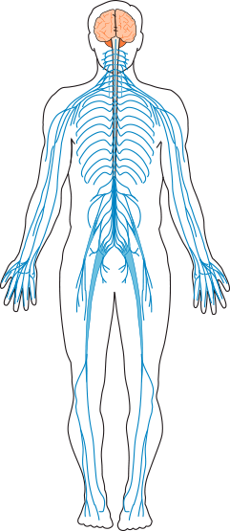
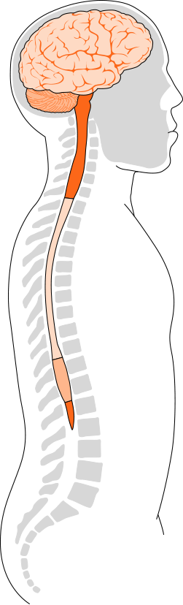
The Human Nervous System
The brain and spinal cord make up the central nervous system.
All other nerves in the body form the peripheral nervous system.
Illustrations © Williams & Wilkins. All rights reserved.
Notes:
The brain is the command center of the central nervous system; it controls virtually all functions of the body. The brain’s main communication channel to the rest of the body is the spinal cord. Nerves branch out from the spinal cord and send and receive information. All other nerves in the body form the peripheral nervous system.
Reference:
From the Brain Chemistry Teacher’s Guide activity, “The Brain.” Brain Chemistry Teacher’s Guide © Baylor College of Medicine (ISBN: 978-1-888997-45-3) was supported, in part, by funds from the National Institutes of Health, Science Education Partnership Award grant number R25RR13454, and the NIH Blueprint for Neuroscience Research Science Education Award, National Institute on Drug Abuse and NIH Office of the Director, grant number 5R25DA033006.
Image reference:
Illustrations © Williams & Wilkins. All rights reserved.

Slide 6
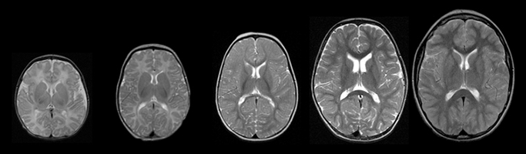
Normal Brain Development
The MRI images above show normal brain development (left to right) at ages 1 week, 3 months, 1 year, 2 years, and 10 years.
Images such as these serve as a baseline for pediatricians when determining problems within the brain.
MRI image courtesy of NIH from the MRI Study of Normal Brain Development Project.
Notes:
MRI images of brain development taken at ages 1 week, 3 months, 1 year, 2 years and 10 years.
Reference:
From the Brain Chemistry Teacher’s Guide activity, “The Brain.” Brain Chemistry Teacher’s Guide © Baylor College of Medicine (ISBN: 978-1-888997-45-3) was supported, in part, by funds from the National Institutes of Health, Science Education Partnership Award grant number R25RR13454, and the NIH Blueprint for Neuroscience Research Science Education Award, National Institute on Drug Abuse and NIH Office of the Director, grant number 5R25DA033006.
Image reference:
MRI courtesy of NIH from the MRI Study of Normal Brain Development project. http://pediatricmri.nih.gov/nihpd/info/index.html

Slide 7
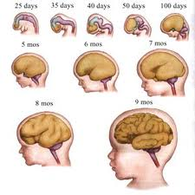
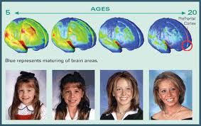
As you get bigger, so does your brain!
Your brain continues to grow and change throughout your life.

Slide 8

What does your brain do?
Thinking!
Using your senses
Moving your body
Sleeping and dreaming
Feeling emotion

Slide 9
What is your brain made of?
The brain is made up of special cells called neurons
These neurons have their own way to talk to each other and send messages through the brain and even to the body

Slide 10
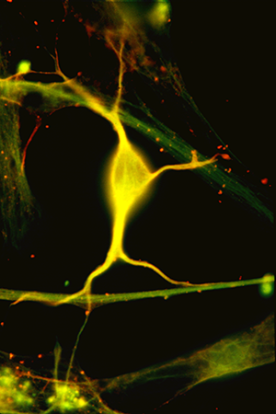
What Is a Neuron?
Microscopic image of a neuron from the hippocampus.
Most neurons receive signals from many other neurons.
The combined effects of these signals determine the response of the receiving neuron.
© Baylor College of Medicine\Robert S. McNeil.
Notes:
The human brain is the most complex structure in the known universe. Consisting of close to 100 billion nerve cells (and many times that number of supporting cells), the brain is the center of our thoughts and emotions. It receives and processes information from the world around us, directs our movements and controls automatic functions of our bodies. Amazingly, virtually all functions of the brain and the rest of the nervous system are based on communication among nerve cells, also known as neurons.
Reference:
From the Brain Chemistry Teacher’s Guide activity, “What Is a Neuron?” Brain Chemistry Teacher’s Guide © Baylor College of Medicine (ISBN: 978-1-888997-45-3) was supported, in part, by funds from the National Institutes of Health, Science Education Partnership Award grant number R25RR13454, and the NIH Blueprint for Neuroscience Research Science Education Award, National Institute on Drug Abuse and NIH Office of the Director, grant number 5R25DA033006.
Image reference:
Microscopic image © Baylor College of Medicine\Robert S. McNeil. http://www.neuralimages.org/

Slide 11
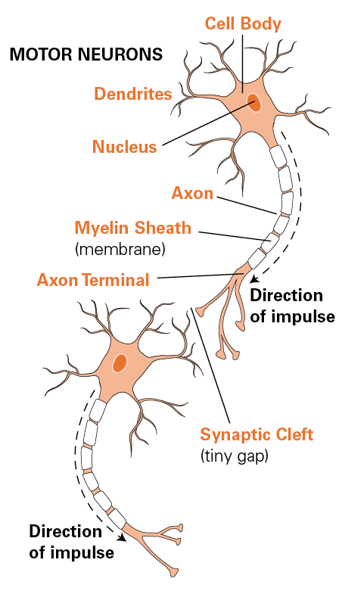
Typical Structure of Neurons
A typical neuron has an enlarged cell body which contains the nucleus.
Most neurons have branches, dendrites, and a longer tail-like fiber, or extension, called an axon.
Information typically is received on the dendrites or cell body, and is transmitted in one direction down the axon and passed to next neuron.
Neurons vary greatly in size and shape. (generally have only a single axon, but can have 100s of dendrites.
Illustration © Williams & Wilkins. All rights reserved.
Notes:
A typical neuron has an enlarged area, the cell body, which contains the nucleus. Neurons typically also have two types of specialized extensions that project away from the cell body. The branches on which information is received are known as dendrites. Each neuron usually has many dendrites. Each neuron usually also has a longer tail-like structure, or axon, which transmits information to other cells.
Axons can be branched at their tips. The axons of many kinds of neurons are surrounded by a fatty, segmented covering called the myelin sheath. This covering acts as a kind of insulation and improves the ability of axons to carry nervous system signals rapidly. In humans, axons can vary from only a fraction of an inch to more than 3 feet in length! The longest axons extend from the base of the spine all the way to the big toe of each foot.
Neurons communicate with one another through special junctions known as synapses. With the most common type of synapse, known as a chemical synapse, neurons do not actually touch. Rather, the end of the axon (or axon terminal) of one neuron is separated from the next neuron by a tiny gap called a synaptic cleft. Messages traveling from one neuron to the next must cross this gap and bind to the next neuron for the signal to continue along its path. Typically, a single neuron may be capable of receiving messages simultaneously on its dendrites and cell body from several thousand different neurons.
Reference:
From the Brain Chemistry Teacher’s Guide activity, “Neural Network Signals.” Brain Chemistry Teacher’s Guide © Baylor College of Medicine (ISBN: 978-1-888997-45-3) was supported, in part, by funds from the National Institutes of Health, Science Education Partnership Award grant number R25RR13454, and the NIH Blueprint for Neuroscience Research Science Education Award, National Institute on Drug Abuse and NIH Office of the Director, grant number 5R25DA033006.
Image reference:
Illustration © Williams & Wilkins. All rights reserved.

Slide 12
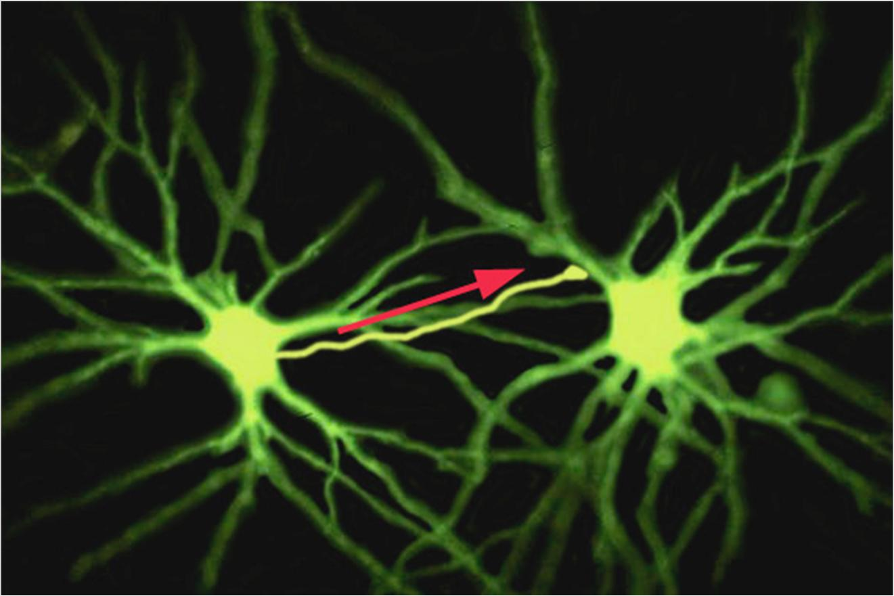
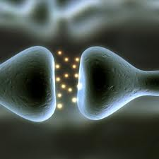

Slide 13
How many neurons do you think are in the brain?
10,000
1,000,000
100,000,000
100,000,000,000
1,000,000,000

Slide 14
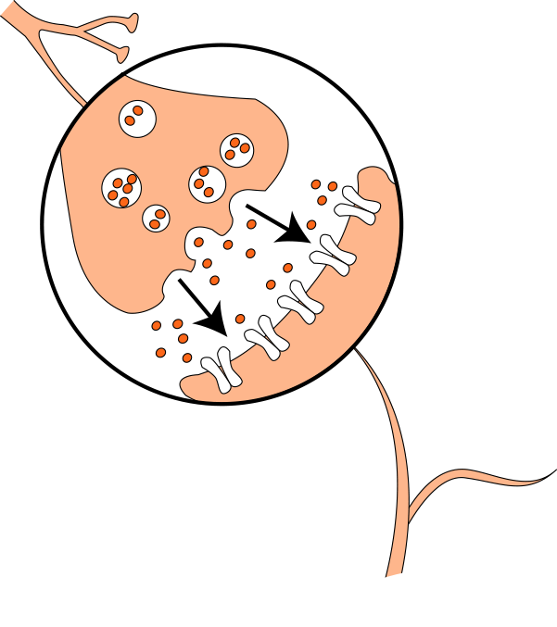
Chemical Communication
In most cases, communication across the synapse occurs chemically instead of electrically.
Neurotransmitters can either promote or inhibit the firing of receiving neurons.
Illustration © Baylor College of Medicine\M.S. Young.
Notes:
Each of the billions of neurons in the nervous system communicate with one another and with other cells, such as muscle cells, through special junctions known as synapses. Some neurons share synapses with thousands of other cells. Others connect with only a few cells.
In some cases, instead of binding to the receiving neuron, neurotransmitters simply float (diffuse) away from the synapse. Other neurotransmitters are broken down or degraded by enzymes found within the synaptic cleft. Many neurotransmitters are transported, whole, back into the neuron that released them. Some drugs, such as cocaine and fluoxetine (Prozac®), exert their effects by interfering with the removal of neurotransmitters from the synapse.
Sometimes, neurons do not communicate through neurotransmitters. Instead, an electrical charge passes directly from neuron to neuron through what is known as an electrical synapse. This type of signaling, in which the communicating neurons are very close together, is very fast and allows many interconnected neurons to fire at the same time. Electrical synapses are less common than chemical synapses, but they are very important for the normal development and function of the nervous system.
Reference:
From the Brain Chemistry Teacher’s Guide activity, “Neurotransmitters Contain Chemicals.” Brain Chemistry Teacher’s Guide © Baylor College of Medicine (ISBN: 978-1-888997-45-3) was supported, in part, by funds from the National Institutes of Health, Science Education Partnership Award grant number R25RR13454, and the NIH Blueprint for Neuroscience Research Science Education Award, National Institute on Drug Abuse and NIH Office of the Director, grant number 5R25DA033006.
Image reference:
Illustration © Baylor College of Medicine\M.S. Young. http://www.bcm.edu/

Slide 15
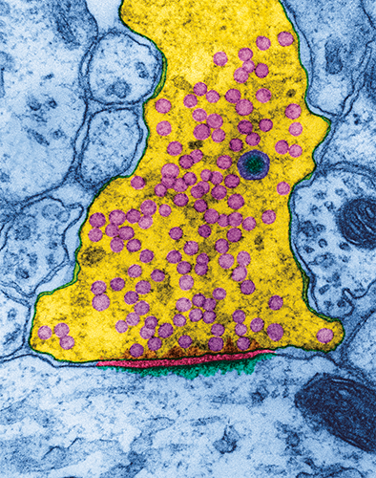
Crossing the Synapse
This microscopic image has been modified to reveal the synaptic cleft between the axon of a nerve cell in the hippocampus (part of the limbic system needed for memory) and a receiving neuron.
Vesicles (small, circular pink objects) release neurotransmitters into the synaptic cleft.
Transmitting Neuron
Synaptic Gap
TEM image © Dennis Kunkel Microscopy, Inc.
Notes:
Most neurons in the brain communicate with each other by releasing chemical messengers called neurotransmitters. Neurotransmitters cross the gaps between neurons or between neurons and other cells, such as muscle, and match up with specific receptors. Chemical signaling between neurons allows different kinds of messages to be sent. For example, some chemical messengers stimulate neurons to fire, while other messengers make it harder for an electrical impulse to be generated in the receiving neuron. Since one neuron can share synapses with thousands of other neurons, the combined effects of different messages ultimately determine whether a signal will be triggered or not.
Many drugs interfere with communication between nerve cells. Some drugs act directly on neurons, neurotransmitters and receptors. Curare, for example, is a deadly poison used by South American Indians. It causes death from paralysis by blocking receptors on muscle cells. Since the receptors are blocked, the real chemical messenger for muscle contraction (acetylcholine) can no longer stimulate the muscles to contract.
Drugs also can interfere with communication between neurons in other ways, such as by preventing the manufacture or release of neurotransmitters, by causing excessive firing of neurons by stimulating massive releases of neurotransmitters, by mimicking the effects of chemical messengers, or by preventing the normal breakdown and recycling of chemical messengers.
Reference:
From the Brain Chemistry Teacher’s Guide activity, “Crossing the Synaptic Gap.” Brain Chemistry Teacher’s Guide © Baylor College of Medicine (ISBN: 978-1-888997-45-3) was supported, in part, by funds from the National Institutes of Health, Science Education Partnership Award grant number R25RR13454, and the NIH Blueprint for Neuroscience Research Science Education Award, National Institute on Drug Abuse and NIH Office of the Director, grant number 5R25DA033006.
Image reference:
Transmission electron microscopic image of the synaptic gap between two neurons. TEM image © Dennis Kunkel Microscopy, Inc. http://education.denniskunkel.com/catalog/home.php

Slide 16
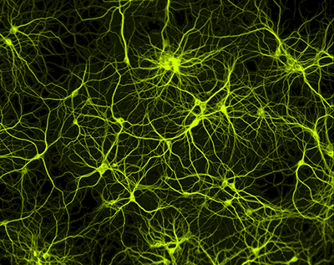
Neuron Circuits
When a neuron “fires,” it sends an impulse to one or more other neurons.
Some neurons are coupled directly, so that an electrical signal traveling down one neuron passes directly to the next one.
Other neurons use chemical messengers, known as neurotransmitters, to send signals to other neurons (motor neuron)
SEM courtesy of Paul De Koninck, PhD, Laval University.
Notes:
Chemical changes along the length of a neuron's cell membrane cause an electrical charge to move in one direction along the length of the cell's axon. Once the signal reaches the end of the axon, it is passed to the next nerve cell either electrically or by a chemical messenger that crosses the synaptic cleft between nerve cells.
Once the signal reaches the end of the axon (or axon terminal) of a neuron, it must move through the synaptic cleft to the next neuron. At the most common type of synapse, known as a chemical synapse, the impulse triggers the release of chemical messengers, called neurotransmitters, from special pockets known as vesicles.
Reference:
From the Brain Chemistry Teacher’s Guide activity, “Neural Network Signals.” Brain Chemistry Teacher’s Guide © Baylor College of Medicine (ISBN: 978-1-888997-45-3) was supported, in part, by funds from the National Institutes of Health, Science Education Partnership Award grant number R25RR13454, and the NIH Blueprint for Neuroscience Research Science Education Award, National Institute on Drug Abuse and NIH Office of the Director, grant number 5R25DA033006.
Image reference:
Scanning electroni microscope image of a neural network. SEM courtesy of Paul De Koninck, PhD, Laval University. http://www.greenspine.ca/

Slide 17

Flying Through Brain Circuits

Slide 18
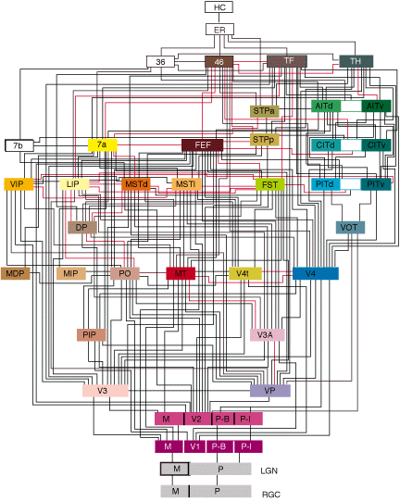
Easy to See, But Complicated to Understand

Slide 19
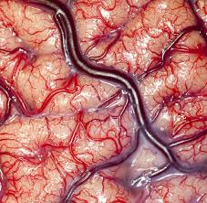
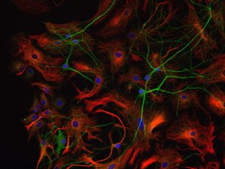
But there’s more!
The brain is also made up of lots of glial cells…
…and lots of blood vessels!

Slide 20
What do the different parts of the brain do?
Each section of the brain has a specific job
Some areas are specialized to do just one thing, like to see or to smell
Other areas get information from all over and combine it into one message

Slide 21
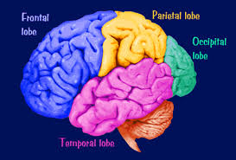

Slide 22
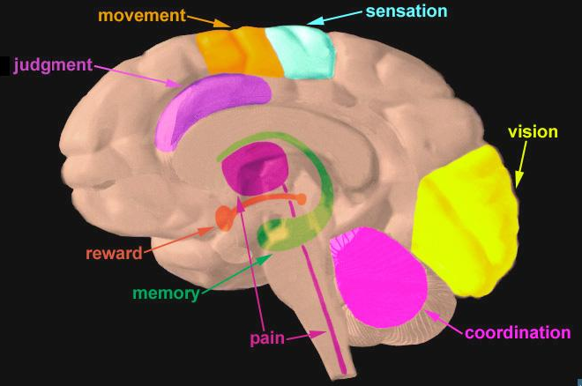

Slide 23
Brain control of the body
The brain controls everything your body does
Interestingly, the left side of your brain controls the right side of your body.
And, the right side of your brain controls the left side of your body.

Slide 24
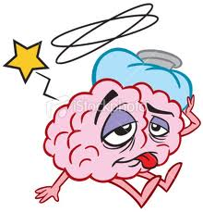
How do we know all of this?
When a part of the brain stops working, we can observe problems with functioning.
Damage or disease in specific areas of the brain can cause unique changes in health and behavior that allow us to understand what different parts of the brain do.

Slide 25

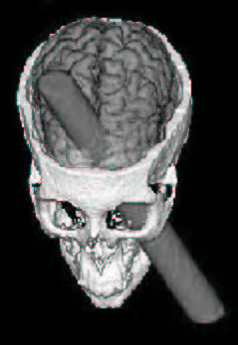
PHINEAS GAGE
Phineas Gage was a railroad worker in the 1800s
In 1848, while blasting through rock, there was an explosion and a tamping rod went through his skull

Slide 26

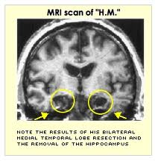
Patient “H.M.”
Had most of his hippocampus removed to stop a seizure disorder.
The surgery was successful, but he could no longer form new memories!
26

Slide 27
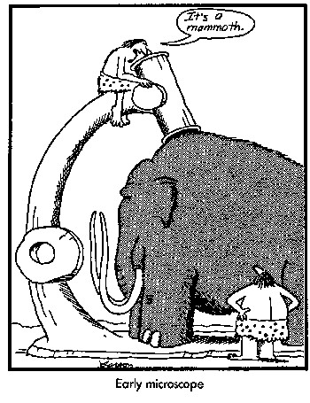
The importance of research
What causes brain disorders?
What do these disorders tell us about the brain?
Can we develop effective therapeutics to treat these disorders?

Slide 28
Mammalian Brain Size
Different animals have different sized brains
Some of them are small, some large, some are smooth some are not…
Can you figure out what animal these brains belong to?

Slide 29
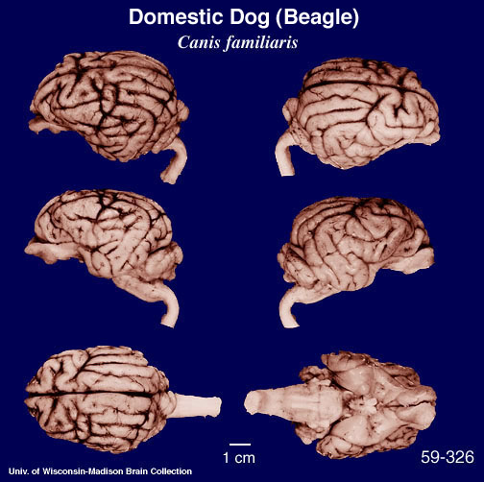

This is an animal you might find around your house, he’s got a great sense of smell and very good hearing… Give up?
It’s a dog!

Slide 30
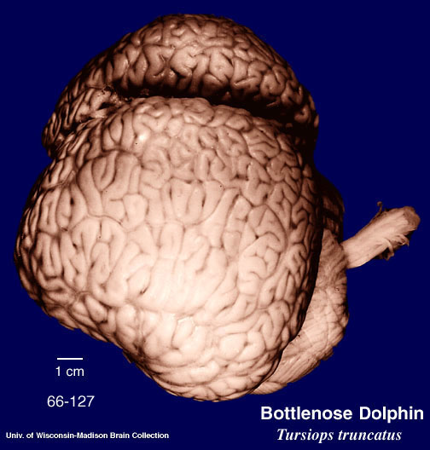

This animal is a great swimmer and communicates using high pitched calls… Figured it out?
It’s a dolphin! Their brains are even bigger than ours.

Slide 31
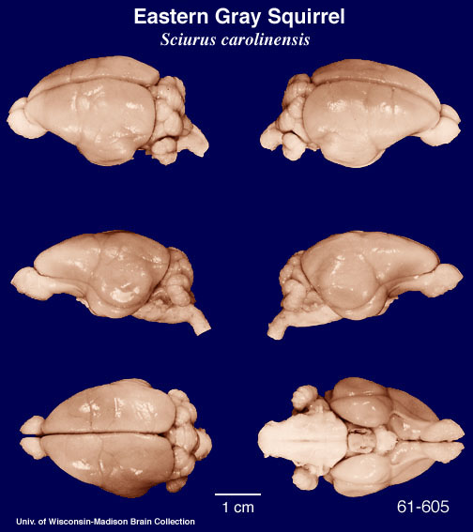

This animal might live in your backyard; they collect nuts and store them in nests inside of trees… Any Guesses?
It’s a squirrel! Do you see how smooth this brain is compared to the dolphin brain?

Slide 32
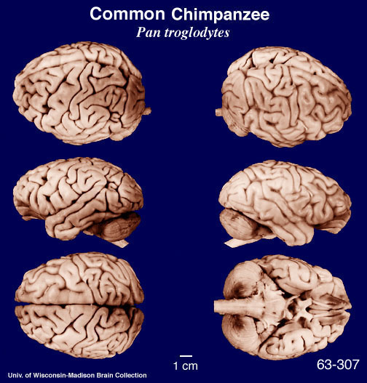

This animal lives in Africa and is our closest mammalian relative
It’s a chimpanzee! Look how similar their brains look to ours.

Slide 33
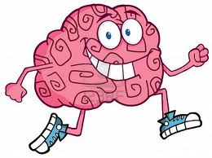
Protect your brain!
Now that you know all about the brain, how can you protect yours?
Wear your seatbelt!
Wear a helmet!
Get lots of sleep!
Exercise and Nutrition!

Slide 34
More great questions
What happens when a person is deaf?
When you are blind, is that an eye problem or a brain problem?
What happens when a person has a stroke?
Where do dreams come from and why can’t we remember all of them?
What is your subconscious?

Slide 35
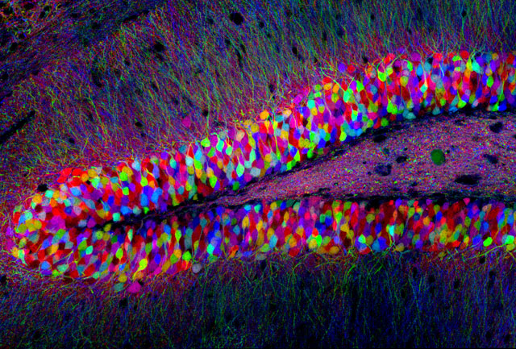
Thank you!!
Any more questions???

